Slide 1
IP Analytics Exercise
Interim session slide deck
© Tietze, F., Clarke, N. (2025)
This material is shared under a Creative Commons license, CC BY 4.0
Notes:
Opening slide

Slide 2
Agenda
1
Welcome and recap from Part I
10min
Interim presentations – 2 x
2
20min
Interim presentations – 2 x
10min break
20min
3
Introduction to Part II of the exercise
40min

Slide 3
Learning objectives
To understand how to use patent data:
  to identify and evaluate existing technical solutions
  to identify and evaluate commercialisation partners
  to understand what one can infer from patent data and what not (limitations)
More specifically to understand:
  pros/cons of different databases → selecting databases for the task at hand
  how to develop effective search strategies and database associated challenges
Understand and use the following concepts and associated challenges / limitations when interpreting them:
  legal status
  patent classifications
  patent families
  patent citations

Slide 4
Recap of your task
You work for a mid-sized UK-based company. Your company currently has manufacturing sites in Birmingham (UK) and Brussels (BE), but wants to internationalise in the next five years.
You are looking to develop a novel multi-technology product/process based on your own technology base for which you have secured relevant IP rights. However, you are missing expertise/capabilities in a certain technology, which has been developed and patented by others.
Your are tasked to evaluate the patent literature to identify suitable technical solutions and recommend to your CEO the technology you should aim to use, possibly have to acquire (i.e. buy or in-license).
--> Mid-term presentations!
Now, your CEO has decided and acquire the missing technology. The product/process is ready for commercialisation. However, your company does not possess the resources to commercialise the product/process abroad fully on its own, but will need to find partners. Which commercialisation partner(s) should your company approach preferably?

Slide 5
Timeline
Part 1
Part 2
Introduction to IP
(preferably preparatory lecture)
Kickoff
Patent Analytics Exercise
Kick off
(2 hrs)
Interim session
Patent Analytics Exercise
Interim presentations + briefing for Part 2
(2hrs)
Final session
Patent Analytics Exercise
Final presentations
(2 hrs)

Slide 6
A simplified innovation process view for this exercise
T_{i}
Market launch
(requires freedom to operate)
Out-licensing
In-licensing
Own technology base
(IP portfolio)
Phase 1: Technical product development
Phase 2: Commercialization
(domestic + internationalisation)
Part 1
Mid-term
presentation
Part 2
Final
presentation

Slide 7
Expected deliverables
Interim presentation: max. 10min + 5min Q&A
  Focused on pre-market launch patent analysis (technology development)
  Identification of existing technical solutions and who owns them
  Evaluation of the technical solutions you identified + clear reasoning for the preferred solution
  Include an explanation of:
      how you developed your search strategy
      how you analysed the data
    Short reflection of your experience and challenges / limitations you encountered during the patent analysis

Slide 8
Presentations

Slide 9
Instructions to Part II

Slide 10
A simplified innovation process view for this exercise
T_{i}
Market launch
(requires freedom to operate)
Out-licensing
In-licensing
Own technology base
(IP portfolio)
Phase 1: Technical product development
Phase 2: Commercialization
(domestic + internationalisation)
Part 1
Mid-term
presentation
Part 2
Final
presentation

Slide 11
Part II - Your task
You work for a mid-sized UK-based company. Your company currently has manufacturing sites in Birmingham (UK) and Brussels (BE), but wants to internationalise in the next five years.
You are looking to develop a novel multi-technology product/process based on your own technology base for which you have secured relevant IP rights. However, your are missing expertise/capabilities in a certain technology, which has been developed and patented by others.
Your are tasked to evaluate the patent literature to identify suitable technical solutions and recommend to your CEO the technology you should aim to use, possibly have to acquire (i.e. buy or in-license).
--> Mid-term presentations!
Now, your CEO has decided and acquire the missing technology
The product/process is ready for commercialisation
However, your company does not possess the resources to commercialise the product/process abroad fully on its own, but will need to find partners
Which commercialisation partner(s) should your company approach preferably?
Using your newly acquired patent analytics skills, you are tasked with identifying and evaluating suitable partners to propose the most suitable one!

Slide 12
Expected deliverables
2) Final presentation: max. 10min + 5min Q&A
  Focused on post-market launch patent analysis (unit of analysis = company)
  Identification of potential commercialisation partners
  A patent-data based evaluation of potential commercialization partners + clear reasoning for the preferred partner
  Include an explanation of your approach
      how you identified potential partners
      how you conducted the evaluation
    Short reflection of your experience, challenges you encountered and limitations of the patent analysis

Slide 13
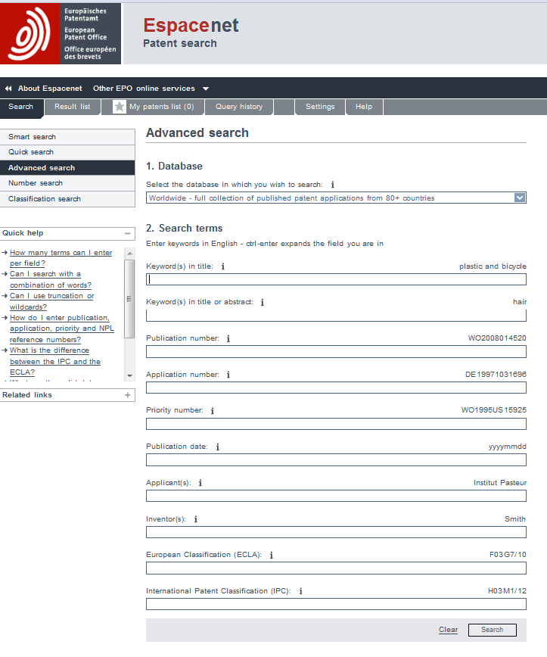

Patent analytics tools

Slide 14
Introduction to patent analytics with focus on identifying commercial partners

Slide 15
Changing focus!
Unit of analysis
Part I
Part II
Technology
Company

Slide 16
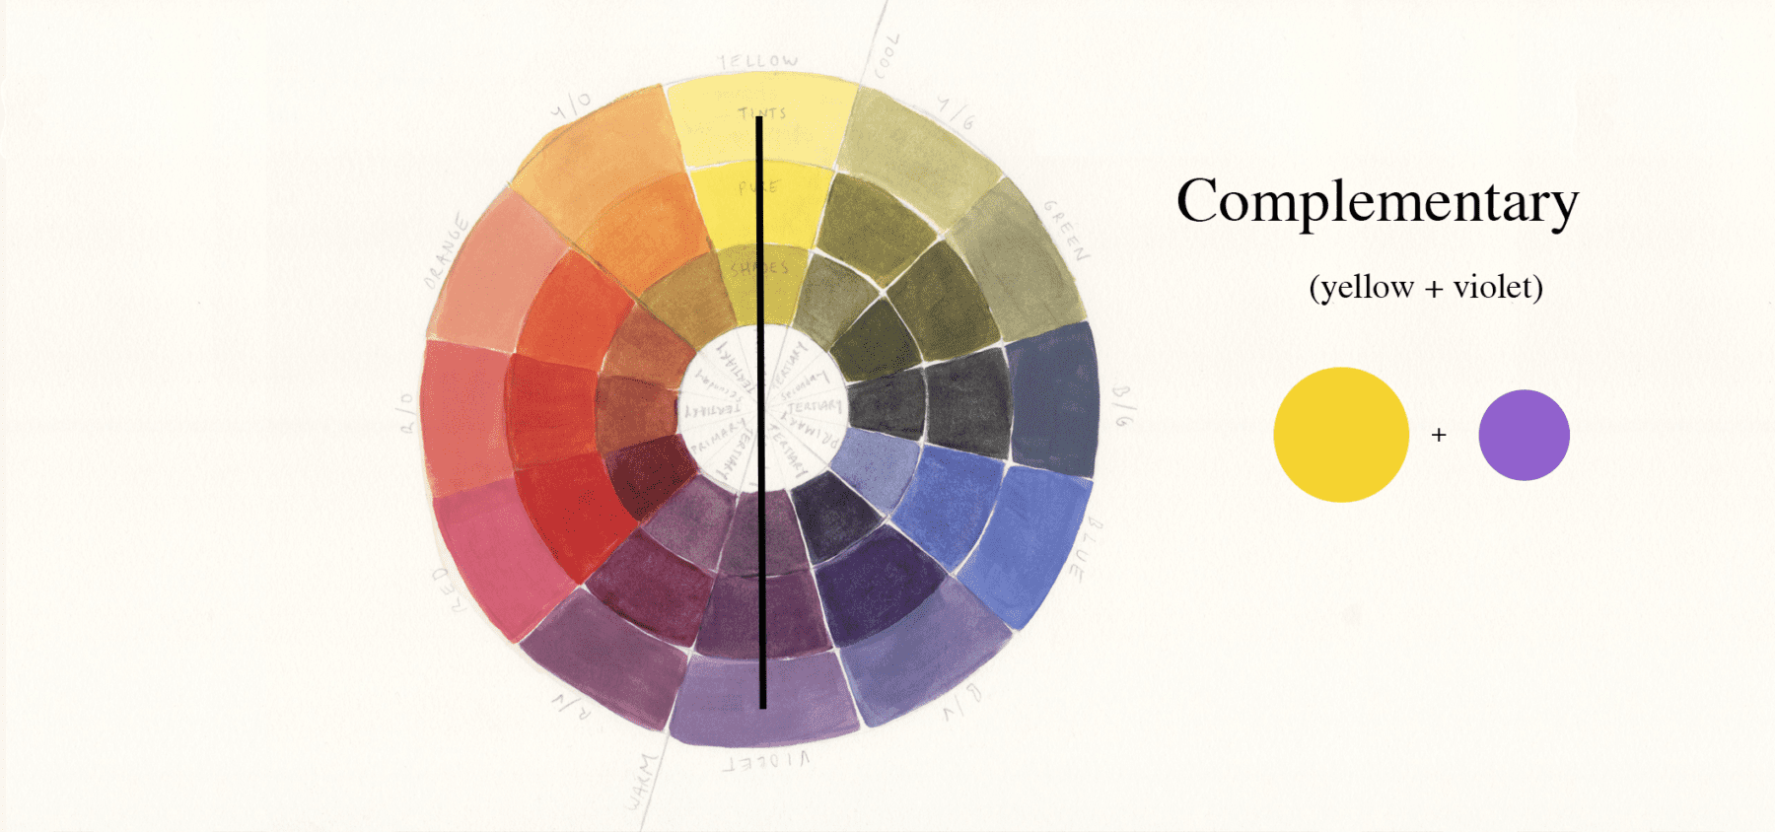
In search for strong patent portfolio complementarity
Image from: www.spirityou.com/the-secret-world-of-yellow-how-to-be-an-expert-at-the-colour-wheel/
“Complementarities among activities occur ‘if doing (more of) any of them increases the returns to doing (more of) the others’. In contrast, activity xi and xj are sub-additive if the implementation of one activity decreases the marginal return from another.” Milgrom and Roberts (1990, 181):

Slide 17


Patent searching exercise – Part II
Bicycle therapeutics is looking for a commercialization partner for its technology in Asia. The IP manager has identified two possible partners:
- Tricycle therapeutics
- Quadcycle therapeutics
Using the four patent indicators:
Patent classifications
Legal status
Patent families
Patent citations
Which might be the better partner?

Slide 18
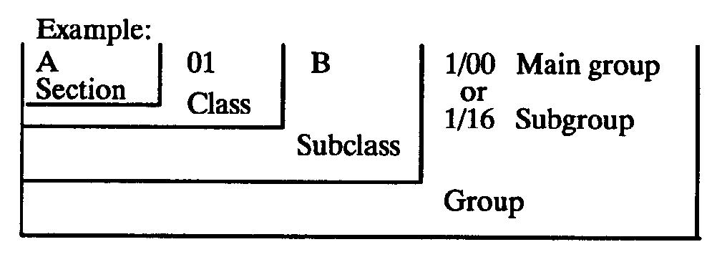
How can classification analysis support the identification of commercial partners?
Patentable technology is broken down into manageable categories
To enable search, examination and grant at patent offices
Three major classification systems
      IPC – International Patent Classification WIPO RoW
      CPC – Cooperative Patent Classification Subdivision of IPC EPO/USPTO
      FI F term – Subdivision of IPC - JPO

Slide 19
Patent Indicator - classifications
Condensation Particle Counter Technology
http://www.eng.cam.ac.uk/news/tracking-airborne-nanoparticles-inform-research-spread-harmful-emissions

Slide 20
Comparing classifications, which company might be the better partner?
Note: Illustrative example for discussion - Dummy data

Slide 21
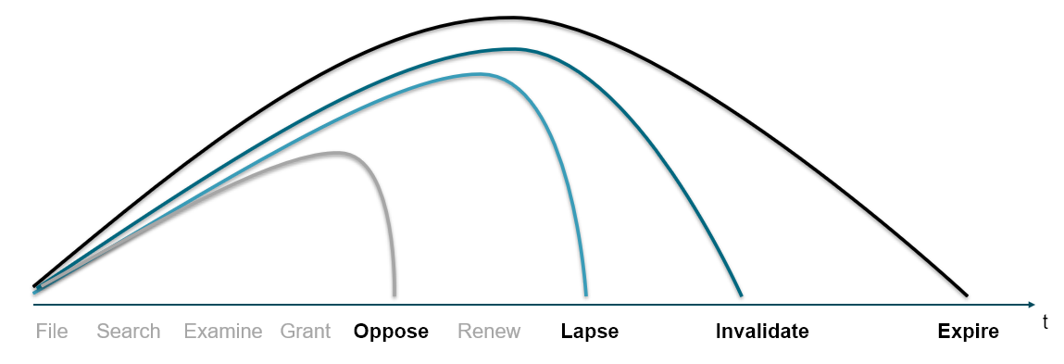
How can a legal status analysis support the identification of commercial partners?
Exclusionary right exists from priority date if granted
Distinction between:
  pending patent applications,
  active (granted) patents,
  ceased patents.
Right ceases if patent :
  is revoked, withdrawn, opposed, invalidated,
  its renewal fees not paid (lapsed),
  expired (20 years from priority date).

Slide 22
Considering the age of a patent portfolio, which company might be the better partner?
Note: Illustrative example for discussion - Dummy data

Slide 23
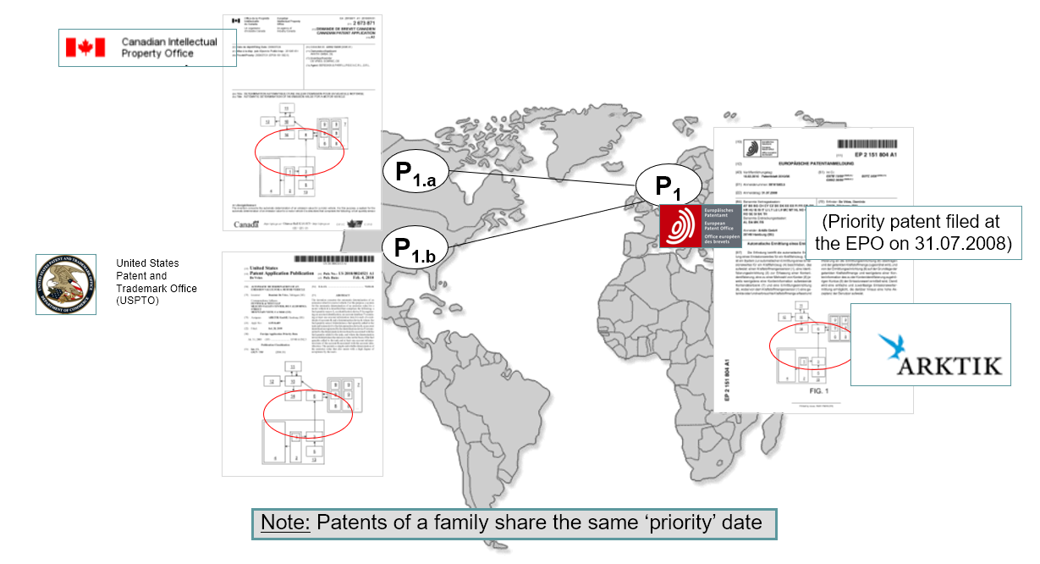
How can a patent family analysis support the identification of commercial partners?
A simple patent family is a set of patent applications filed in respect of a single invention, in multiple patent jurisdictions.
The first filing is the priority filing
Subsequent filings must occur within 12 months of the priority (Paris convention)
Subsequent filings "claim priority" from the first filing
Protection exists everywhere patent is in force
Notes:
Similarity of patent family scope
Strength of a patent portfolio in particular regions
Coverage of patent protection in the market your company wants to enter
Lack of patent protection in the markets in which your company is active

Slide 24
Patent indicator– family size
CAR T-cell immunotherapy
Rank | Applicant | Inventions (# patent families) | Patents (# filed)
1 | Univ Pennsylvania (US) | 54 | 428
2 | Univ College London (GB) | 15 | 117
3 | National Cancer Institute (US Health Dep) (US) | 14 | 98
4 | Memorial Sloan-Kettering Cancer Center (US) | 11 | 80
5 | City Of Hope Research Center (US) | 8 | 59
6 | Univ Texas (US) | 8 | 56
7 | Baylor College of Medicine (US) | 8 | 40
8 | Seattle Childrens Hospital (US) | 6 | 90
9 | Fred Hutchinson Cancer Research Center (US) | 6 | 40
10 | Chinese Pla General Hospital (CN) | 5 | 10
11 | Univ California (US) | 4 | 32
12 | Dana-Farber Cancer Institute (US) | 4 | 17
13 | Univ Köln (DE) | 3 | 10
14 | Univ Washington (US) | 3 | 10
15 | Univ Southern California (US) | 3 | 4
16 | Univ Nagoya (JP) | 3 | 3
17 | Univ North Carolina (US) | 3 | 3
18 | Roger Williams Medical Center (US) | 2 | 16
19 | Ohio State Innovation Foundation (US) | 2 | 14
20 | Forschungsinstitut Georg-Speyer-Haus (DE) | 2 | 14
Jürgens, B., Clarke, N.S. Evolution of CAR T-cell immunotherapy in terms of patenting activity. Nat Biotechnol 37, 370–375 (2019). https://doi.org/10.1038/s41587-019-0083-5

Slide 25
Comparing patent family data, which company might be a better partner for selling your product in Japan?
Note: Illustrative example for discussion – Dummy data

Slide 26
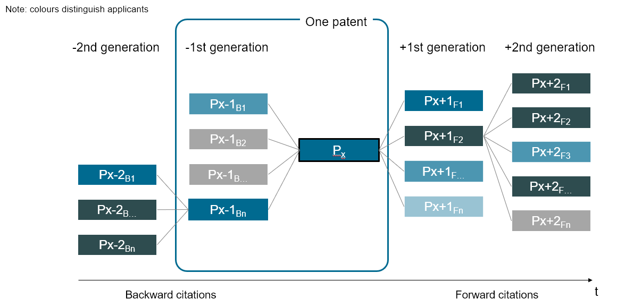
How can citation analysis support the identification of commercial partners?
Backward citations: On a patent document references to previously filed patents
Forward citations: Citations accumulating over time referencing to a patent filed with an earlier priority date
Forward citation frequency: Number of forward citations per year, i.e. since filing / priority date → In order to compare patents of different age
Aristodemou, L. and F. Tietze (2018). "Citations as a measure of technological impact: A review of forward citation-based measures." World Patent Information 53: 39-44.
Notes:
Citation dependencies:
Your company backwards citing their patents
Their patents forward citing your patents
A weak patent portfolio (with few / declining numbers of forward citations) might indicate a need for fresh innovation

Slide 27
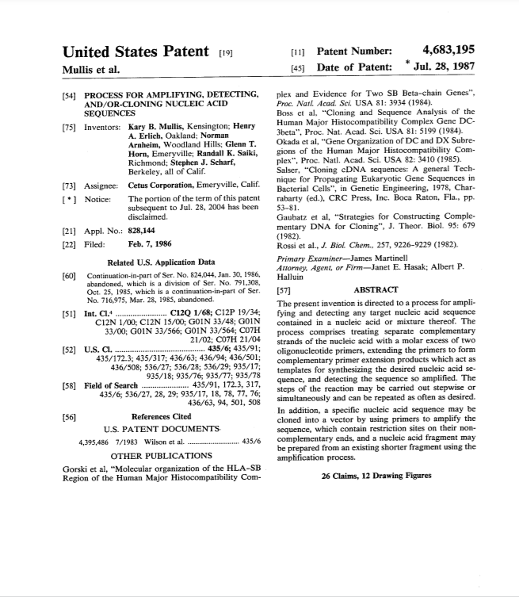
Patent indicator – document citations
US4683195 PROCESS FOR AMPLIFYING DETECTING AND OR CLONING NUCLEIC ACID SEQUENCES
Mullis, Erlich, Arnheim, Horn, Saiki, Scharf
CETUS Corp
Backwards citations; 1 x US patent, 5 x NLP
Forward citations; 8,311 (February 2022) 244/y
Kary B. Mullis Scientific American Vol. 262, No. 4 (APRIL 1990), pp. 56-65

Slide 28
Patent indicator – document citations
CAR T-cell immunotherapy
Jürgens, B., Clarke, N.S. Evolution of CAR T-cell immunotherapy in terms of patenting activity. Nat Biotechnol 37, 370–375 (2019). https://doi.org/10.1038/s41587-019-0083-5

Slide 29
Comparing citation patterns, which company might be the better partner?
Note: Illustrative example for discussion - Dummy data

Slide 30
Results of multidimensional partner complementarity evaluation
Note: Illustrative example for discussion - Dummy data

Slide 31
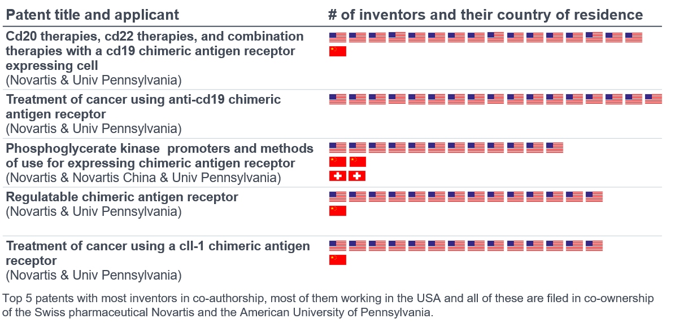
Patent indicator – size of inventor team
CAR T-Cell immunotherapy
Jürgens, B., Clarke, N.S. Evolution of CAR T-cell immunotherapy in terms of patenting activity. Nat Biotechnol 37, 370–375 (2019). https://doi.org/10.1038/s41587-019-0083-5

Slide 32
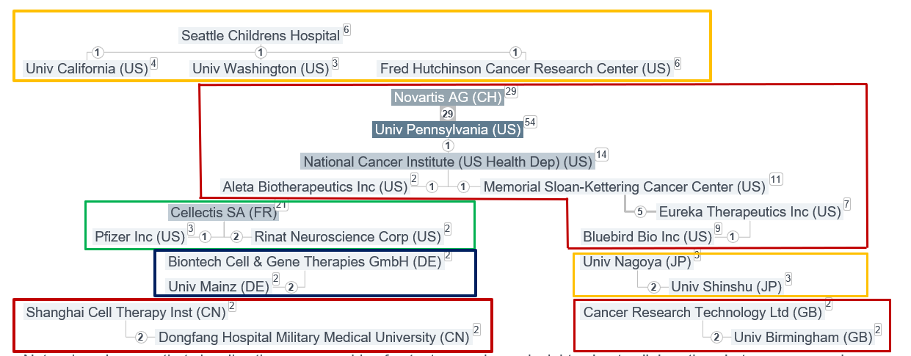
Patent indicator – co-applications
CAR T-cell immunotherapy
Jürgens, B., Clarke, N.S. Evolution of CAR T-cell immunotherapy in terms of patenting activity. Nat Biotechnol 37, 370–375 (2019). https://doi.org/10.1038/s41587-019-0083-5

Slide 33
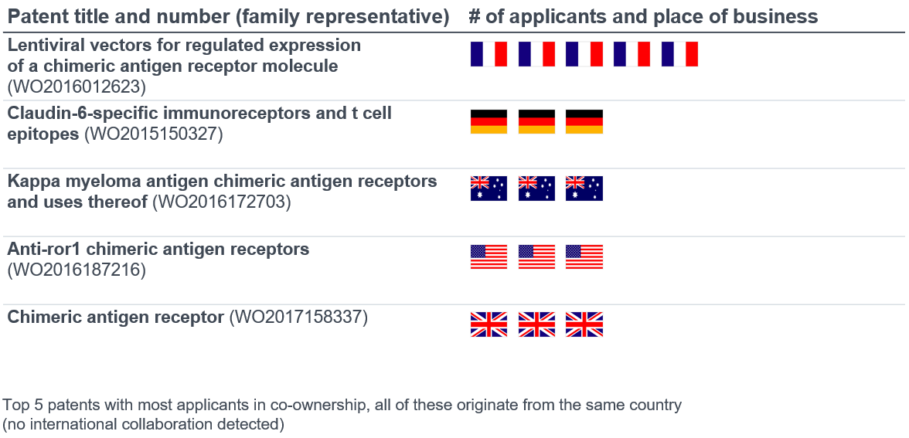
Patent indicator – co-applicants
CAR T-Cell immunotherapy
Jürgens, B., Clarke, N.S. Evolution of CAR T-cell immunotherapy in terms of patenting activity. Nat Biotechnol 37, 370–375 (2019). https://doi.org/10.1038/s41587-019-0083-5

Slide 34
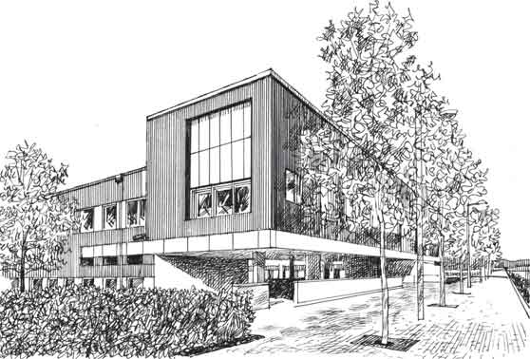
Thank you!

