Slide 1
IP Analytics Exercise
Kickoff slide deck
© Tietze, F., Clarke, N. (2025)
This material is shared under a Creative Commons license, CC BY 4.0
Notes:
Opening slide

Slide 2
Agenda
1
Introduction to the exercise
30min
10min break – form groups!
2
Forming groups
15min
3
Introduction to patent analytics – Part 1
60min

Slide 3
Introduction

Slide 4
Learning objectives
For students to understand how they can use patent databases, more specifically how to use patent data:
  to identify existing technical solutions and whether they are freely available to use
  to understand technology and market trends
  to understand what information one can infer from patent data and what not
More specifically:
  Pros/cons of different databases → selecting databases for the task at hand
  Understand how to develop effective search strategies and data-associated challenges
  Understand what legal status means:
    Filed, pending, granted, in force/active
    Identify patents no longer in force: discontinued (i.e. not renewed), “off patent”
  Understand the concept of patent families and the associated challenges of identifying family members
  Understand challenges around patent ownership
  Understand patent classifications, e.g. IPC, CPC
  Understand and carefully interpret patent citations

Slide 5
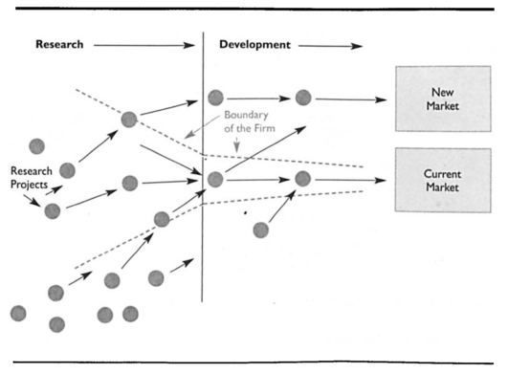
About innovation processes
Chesbrough, H. (2003). "The Logic of Open Innovation: Managing Intellectual Property." California Management Review 45(3): 33-58.

Slide 6
A simplified innovation process view for this exercise
T_{i}
Market launch
(requires freedom to operate)
Out-licensing
In-licensing
Own technology base
(IP portfolio)
Phase 1: Technical product development
Phase 2: Commercialization
(domestic + internationalisation)
Part 1
Mid-term
presentation
Part 2
Final
presentation

Slide 7
Timeline
Part 1
Part 2
Introduction to IP
(preferably preparatory lecture)
Kickoff
Patent Analytics Exercise
Kick off
(2 hrs)
Interim session
Patent Analytics Exercise
Interim presentations + briefing for Part 2
(2hrs)
Final session
Patent Analytics Exercise
Final presentations
(2 hrs)

Slide 8
Your task – the general scenario
Your team works for a mid-sized UK-based company. Your company currently has manufacturing sites in Birmingham (UK) and Brussels (BE), but wants to internationalise in the next five years.
You are looking to develop a novel multi-technology product/process based on your own technology base for which you have secured relevant IP rights. However, you are missing expertise/capabilities in a certain technology, which has been developed and patented by others.
You are tasked to evaluate the patent literature to identify suitable technical solutions and recommend to your CEO the technology you should aim to use, possibly have to acquire (i.e. buy or in-license).
--> Mid-term presentations!
Your CEO has decided on the preferred solution for the missing technology and your company has acquired that one. The product/process is now ready for commercialisation. However, your company does not possess the resources to commercialise the product/process internationally on its own and will need to find partners. Which commercialisation partner(s) should your company approach preferably?

Slide 9
Expected deliverables
Interim presentation: max. 10min + 5min Q&A
  Focus on pre-market launch patent analysis (technology development) for your missing technology
  Identification of ~3 existing, potential technical solutions and who owns them
  A patent-data based evaluation of the technical solutions identified + clear reasoning for the preferred solution
  An explanation of:
      how you developed your search strategy
      how you analysed the data
    Short reflection of your experience and challenges you encountered and limitations of the patent search
2) Final presentation: max. 10min + 5min Q&A
  Focused on post-market launch IP issues (commercialisation / internationalisation)
  → Detailed briefing in mid-term session

Slide 10
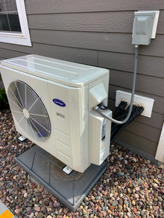
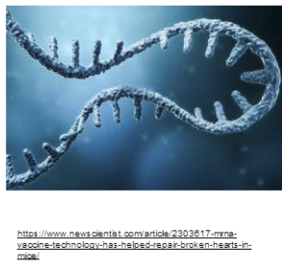
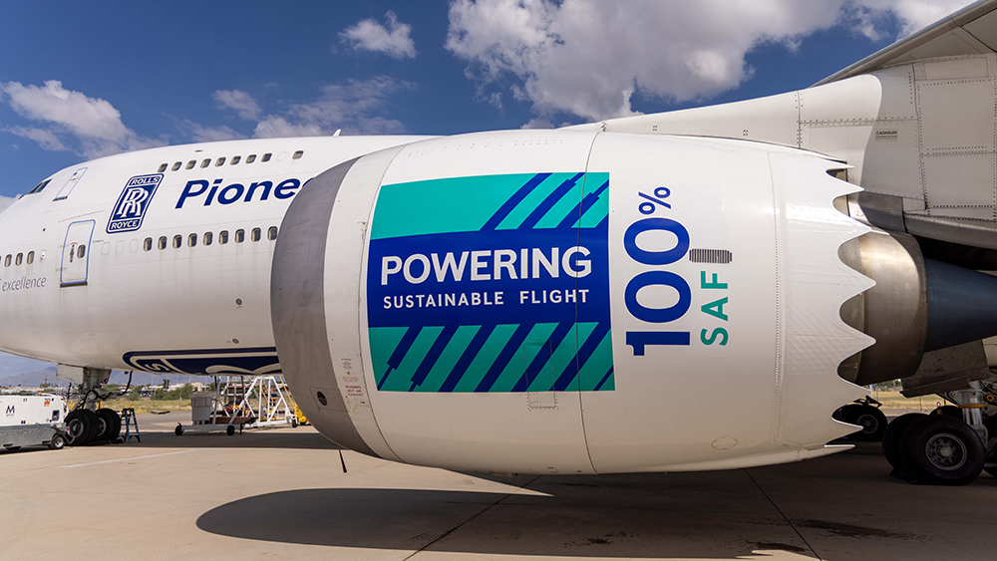

Example topics: Groups of 3-4 participants working on one topic
Heat pumps and greener buildings
Sustainable Aviation Fuel
Recycling Food Packaging
mRNA

Slide 11
Groups
mRNA
Heat pumps and greener buildings
Sustainable Aviation Fuel
Recycling Food Packaging
 | Group 1 | Group 2 | Group 3 | Group 4 | Group 5 | Group 6
Topic
Optional: Assign team members to the following roles:
Business Development Executive, R&D Manager, Technology Intelligence Analyst

Slide 12
The presentation need to fulfil the roles of the executives
As a business development manager, you'll identify new business opportunities in order to generate revenue, improve profitability and help the business grow
The R&D manager is responsible for conducting research, developing new products, processes, and technologies, and improving existing products.
A technology intelligence analyst performs research to provide information to executives or management who use it to craft a new sales project or business strategy.

Slide 13
Introduction to patent analysis

Slide 14

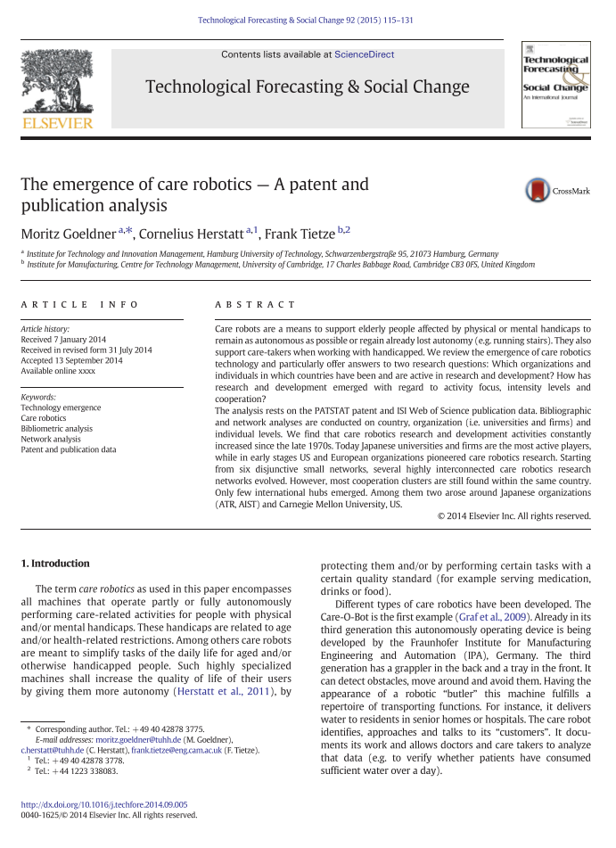
Examples of patent analyses
Actor analysis
Technology emergence analysis
List, J. and F. Tietze (2017 ). Additive Manufacturing Innovations by UK Organisations: A review of patents and academic literature published between 2006 and 2015. Cambridge, UK, Institute for Manufacturing, University of Cambridge. www.ifm.eng.cam.ac.uk/uploads/Download/AMUK2019.pdf
Göldner, M., C. Herstatt and F. Tietze (2015). "The emergence of care robotics – A patent and publication analysis." Technological Forecasting and Social Change 92(March): 115-131. www.sciencedirect.com/science/article/abs/pii/S0040162514002753

Slide 15


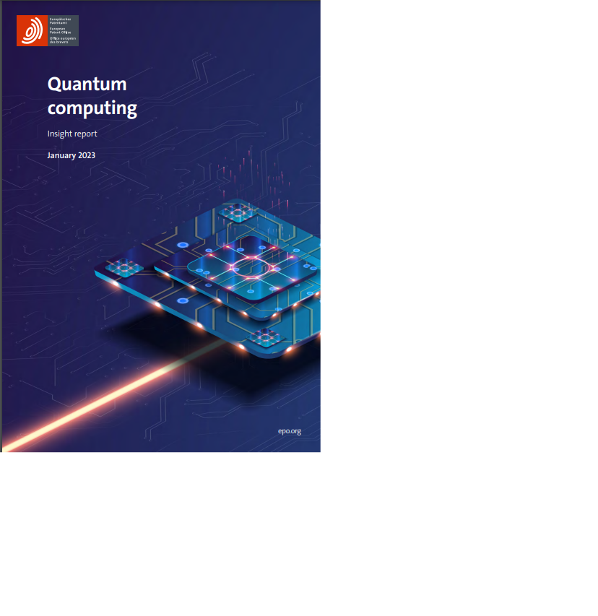

Examples of EPO reports
https://www.epo.org/searching-for-patents/business/patent-insight-reports.html

Slide 16
Databases
Creating reliable datasets
Different types of patent documents/legal status
Patent families

Slide 17

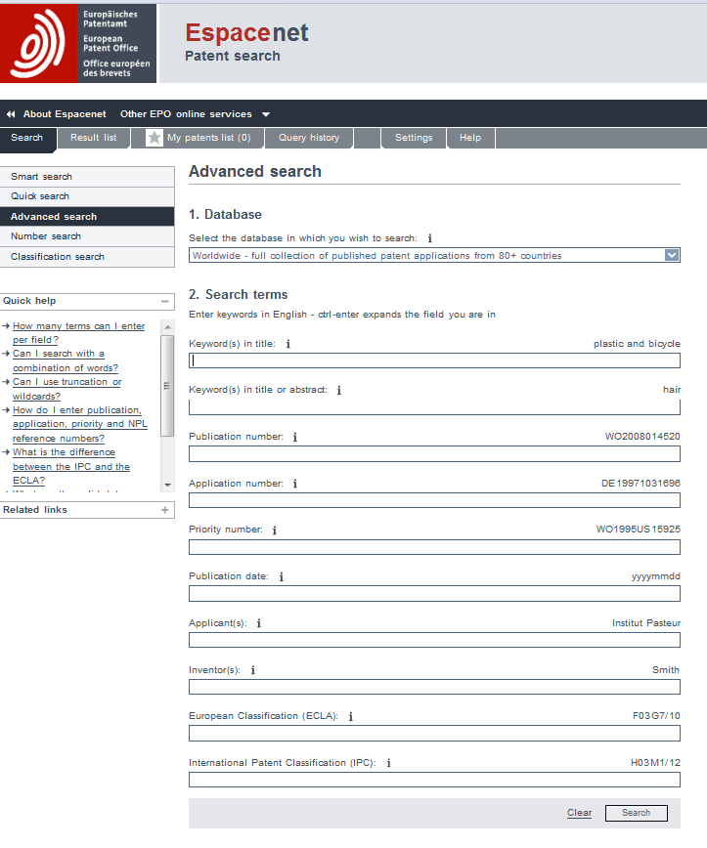
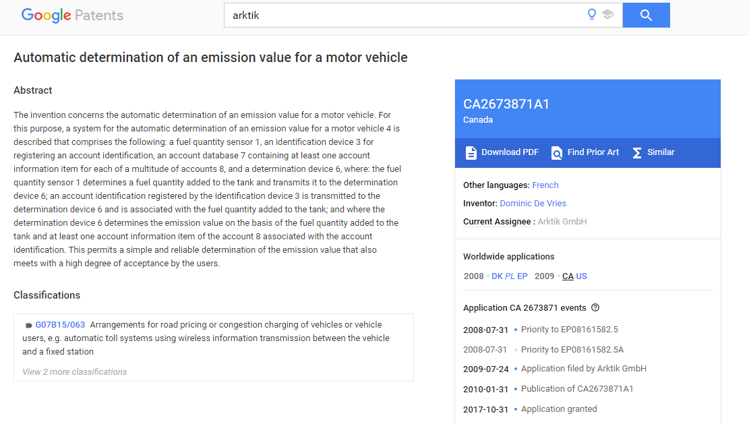
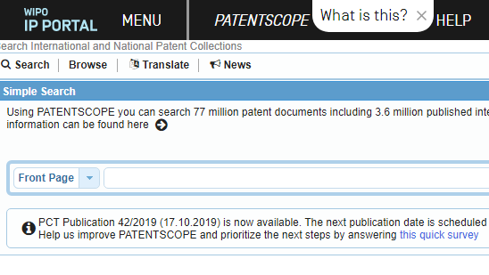
Freely available databases to extract (and analyse) patent data
Patent Office databases
http://worldwide.espacenet.com
https://patentscope.wipo.int/search/en/search.jsf
The Lens.org
https://www.lens.org
Google patents
https://www.google.com/?tbm=pts

Slide 18
Cloud based data sets, eg Google Big Query, PatStat increasingly available for data science approaches
Google Big Query
Fast SQL queries/ Sampling large data
Standardised means of access
Source used initially but then we used python – the data can be easier pre-processed and prepared (and it’s free)
USPTO
Representative sample of the Global Economy (WIPO, 2018)
Used the PatentsView dataset
Granted utility patents (1997-2017)
Source: WIPO 2018, https://www.wipo.int/edocs/pubdocs/en/wipo_pub_941_2018.pdf
Notes:
starting with the data acquisition, we look to the USPTO to collect our data, as representative sample of the global economy.

Slide 19
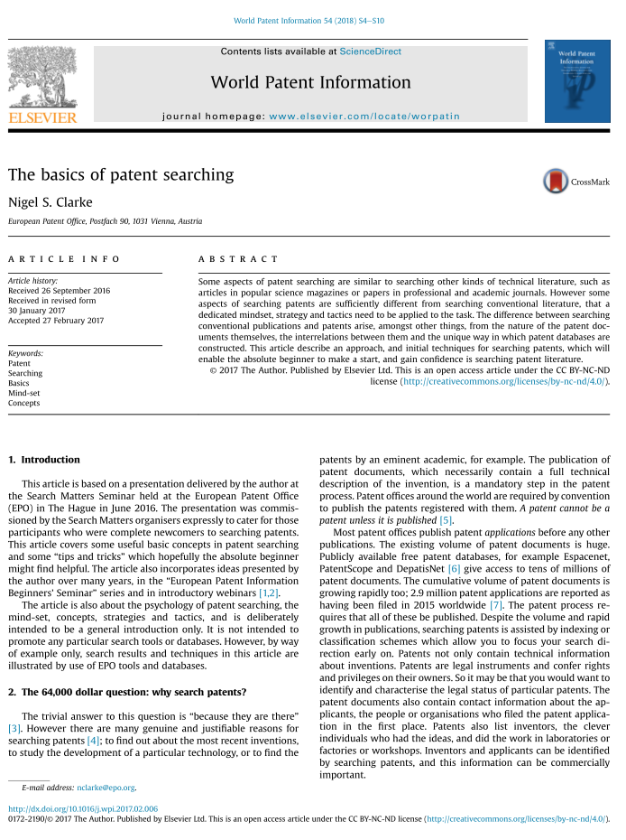
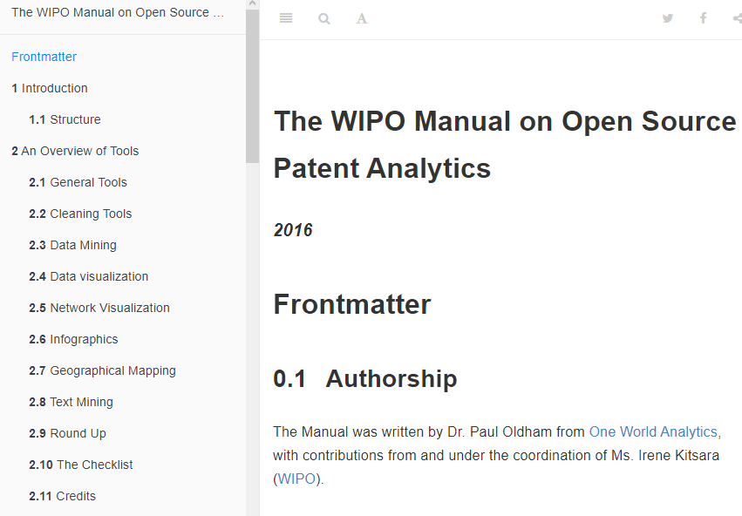
Searching and analysing patents
Regularly updated list of commercial tools: http://piug.org/vendors#AnalysisTool
https://wipo-analytics.github.io/index.html
https://www.sciencedirect.com/science/article/pii/S017221901630103X

Slide 20
Databases
Creating reliable datasets
Different types of patent documents/ status
Patent families

Slide 21
Developing effective search strategies
Population
Sample (data retrieval)
Key word search
(generic functional vs. component specific)
Patent classification search
(e.g. IPC, CPC, )
“Crawling”
(e.g. along forward/ backward citations)
Actor specific searches
(e.g. firms, inventors)
Specific patent status
(e.g. sold, licensed, opposed, litigated)
Content analysis / text searches
(e.g. abstracts, description, claims)
…
Recall
Precision
Two key data retrieval quality criteria
Recall: share of relevant retrieved documents to total number of relevant documents
Precision: share of relevant retrieved documents to the number of retrieved documents
See further
Dirnberger, D. (2011). A guide to efficient keyword, sequence and classification search strategies for biopharmaceutical drug-centric patent landscape searches. World Patent Information, 33(2), 128-143.
Nijhof, E. (2011). Searching? Or actually trying to find something?–The comforts of searching versus the challenges of finding. World Patent Information, 33(4), 360-363.

Slide 22
Developing effective search strategies
 | Applicants | Inventors | Publication Year | Priority Country | Classes
Applicants | Collaboration between organisations | Where are the researchers working | Evolution of filing activity | Home market or most important market | Key technological areas of applicants
Inventors |  | Collaboration between researchers / inventors | Evolution of inventors patenting activity | Inventors´ country of origin | Research fields of the inventors
Publication Year |  |  | Evolution of the activity per country | Evolution of country patent output | Evolution of technology sector
Priority Country |  |  |  | Collaboration between countries | Key technological areas of countries
Classes |  |  |  |  | Relationships between technological domains

Slide 23
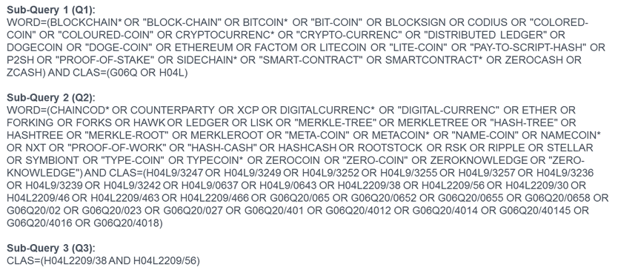
Complex search strategy – statement - blockchain
Keywords, synonyms, truncated terms, classifications, Boolean AND OR NOT
"Blockchain" not good enough – blockchain – bicycle chain – blockchain copolymer
Source: Clarke, Nigel S., Björn Jürgens, and Victor Herrero-Solana. "Blockchain patent landscaping: An expert based methodology and search query." World Patent Information 61 (2020): 101964.

Slide 24
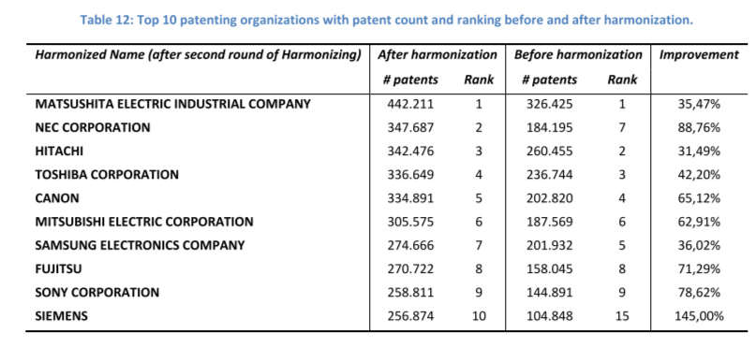
Data quality and the need for cleaning – Example applicant name
Tietze, F. (2012). Technology Market Transactions - Auctions, Intermediaries and Innovation. Cheltenham Edgar Elgar Publishing.
Peeters, B., X. Song, J. Callaert, J. Grouwels and B. Van Looy (2010). Harmonizing harmonized patentee names: an exploratory assessment of top patentees.
Nowadays, certain tools employ a “corporate tree” function

Slide 25
Information contained in patent documents
Inventor
Publication
number
Attention: Applicant means “first owner”,
i.e. not necessarily the current owner!
Granting
date
Applicant/ owner
Application
date
Priority patent
Priority date
Abstract
Technology
classification
Backward citations
Notes:
25
Anyone, who has filed an own patent?
Who of you has not had a patent in the own hands, yet?

Slide 26
Patent data overview – structured and unstructured
Applicant
Name data
Inventor
Text data
Technical data
Patent classification; claims; object; prior art; problems to be solved; solution; technical features; advantageous effect
Others
Cited documents; reference document; trademark; nationality; legal priority
Patent information
Date data
Application; publication; grant; not in force; lapse; revocation:expired
Numerical data
Number data
Application; laid open; publication; specification; correction
Amount data
Number applications; number inventors; number patent; classifications; item of claim
Source: Liu, C.-Y. and J. C. Yang (2008). "Decoding patent information using patent maps." Data Science Journal 7.

Slide 27
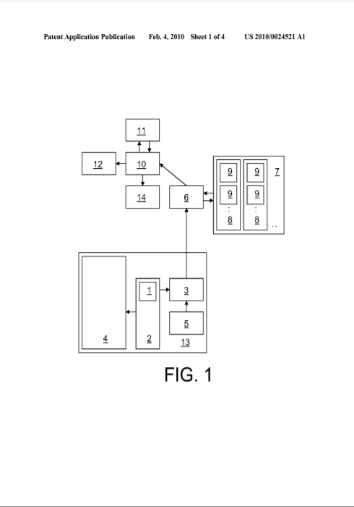
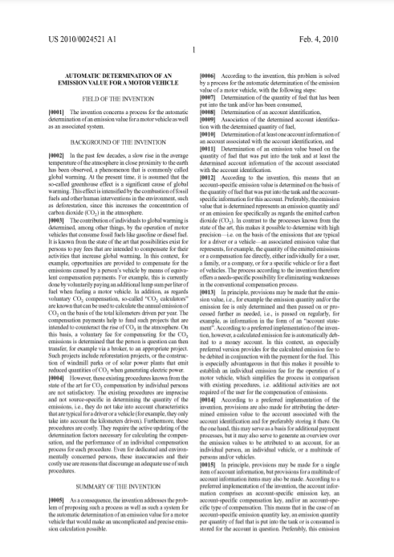
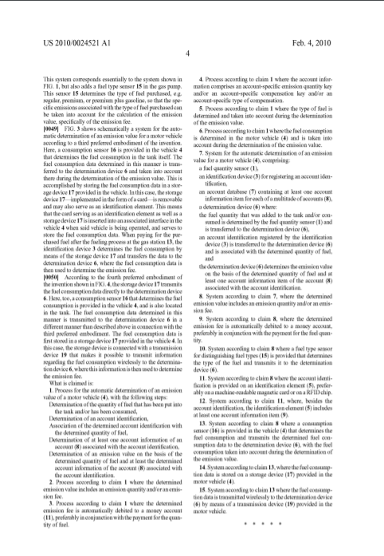
Diagrams Description Claims

Slide 28
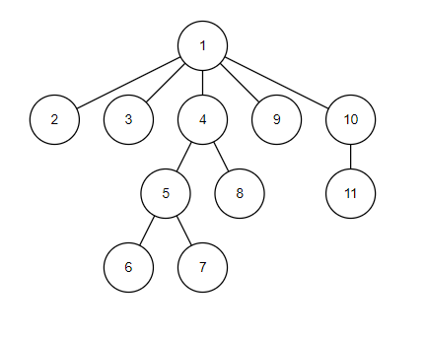
Independent vs dependent claims
Claim tree example
Claim 1 – independent claim
Claims 2,3,4,9,10 dependent on claim 1
Claims 5, 8 dependent on claim 4, claim 11 dependent on claim 10
Claims 6,7 dependent on claim 5

Slide 29
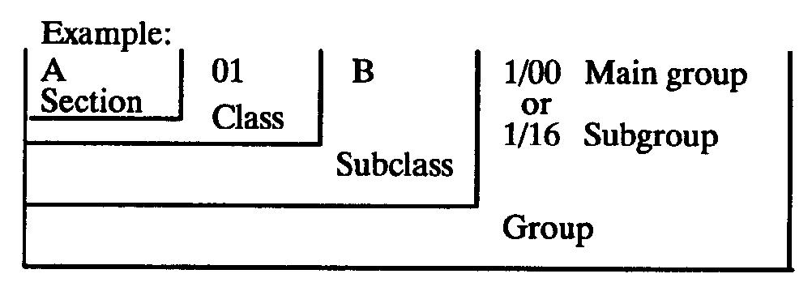
Patent classifications
Patentable technology is broken down into manageable categories
To cope with the huge volume of patent documents already existing and being continually published
To enable search, examination and grant at patent offices
Three major classification systems
      IPC – International Patent Classification WIPO RoW
      CPC – Cooperative Patent Classification Subdivision
      of IPC EPO/USPTO
      FI F term – Subdivision of IPC - JPO

Slide 30
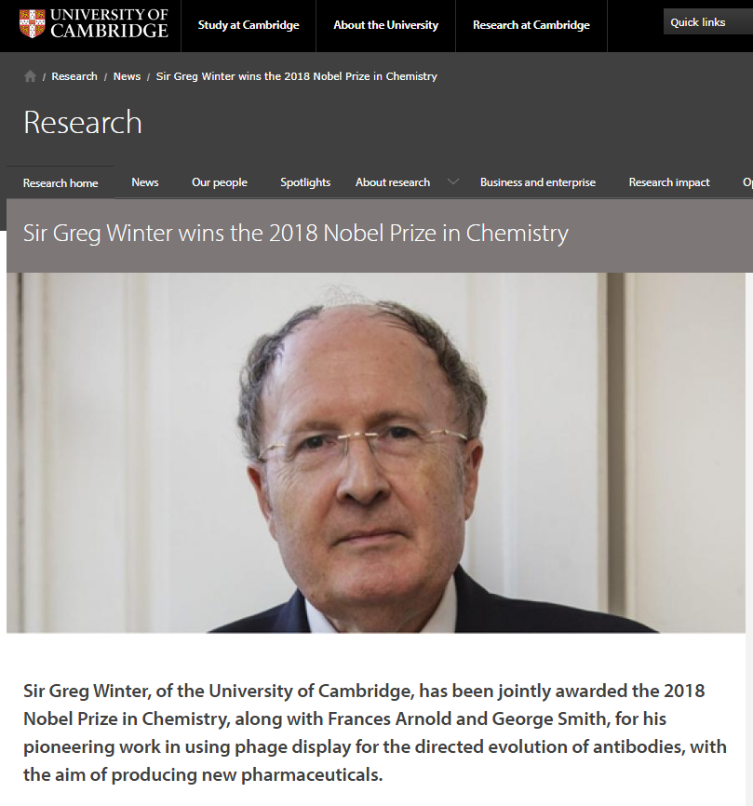
Patent searching exercise – Part I
How many patents have been filed with Gregory Winter as inventor?
In which classes did he file his patents?
Use two databases:
ESPACENET (https://worldwide.espacenet.com)
The Lens (www.lens.org/lens )

Slide 31
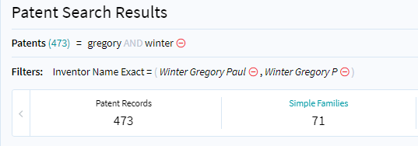
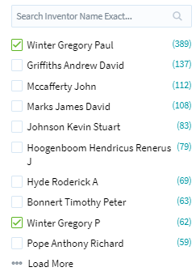
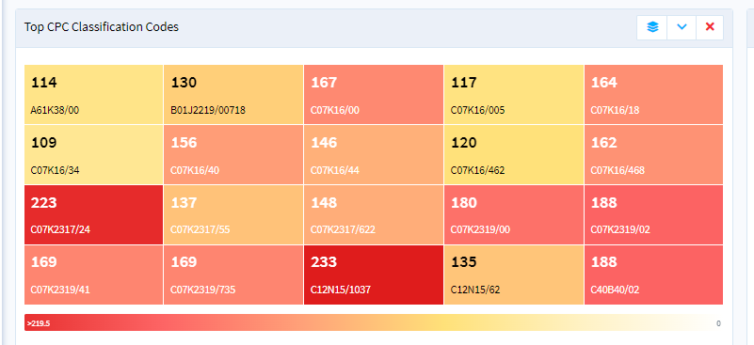

Slide 32
Citation structures evolve over time
Note: colours distinguish applicants
One patent
-2nd generation
-1st generation
+1st generation
+2nd generation
Px+2_{F1}
Px-1_{B1}
Px+1_{F1}
Px+2_{F2}
Px-1_{B2}
Px+1_{F2}
P_{x}
Px+2_{F3}
Px-2_{B1}
Px-1_{B…}
Px+1_{F…}
Px+2_{F…}
Px-2_{B…}
Px-1_{Bn}
Px+1_{Fn}
Px+2_{Fn}
Px-2_{Bn}
Backward citations
Forward citations
t
Aristodemou, L. and F. Tietze (2018). "Citations as a measure of technological impact: A review of forward citation-based measures." World Patent Information 53: 39-44.

Slide 33
Citations reveal hidden relations among actors
Firm₁
Firm₂
Market analysis:
Dedicated databases / Google
Firm level
P₁
P₂
Technology level
Patent informatics
Aristodemou, L. and F. Tietze (2018). "Citations as a measure of technological impact: A review of forward citation-based measures." World Patent Information 53: 39-44.

Slide 34
Databases
Creating reliable datasets
Different types of patent documents/ status
Patent families

Slide 35
Legal status
Exclusionary right
Right to prevent others from exploiting the invention
Right exists from priority if granted
Right ceases if: patent is revoked, renewal fees not paid (lapsed), patent expired (20 years from priority filing date)
Right exists everywhere only while patent is in force (patent family)

Slide 36
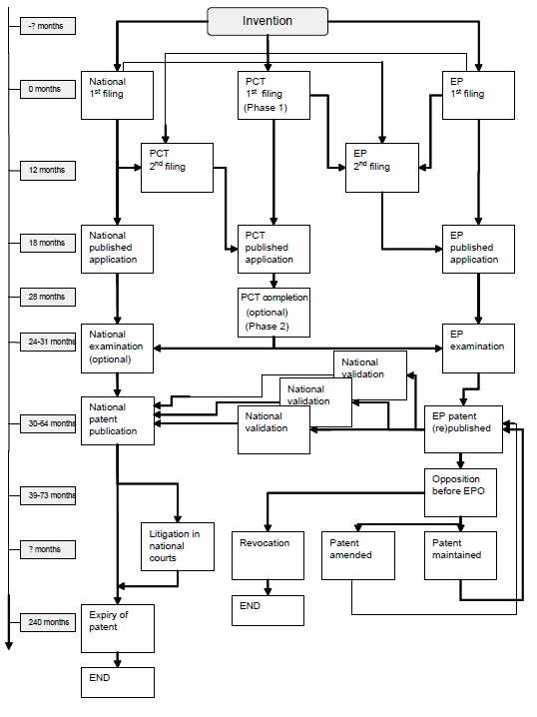
Three main routes to a patent
National
PCT
EPO
12 months priority (30 months PCT)
If the maintenance fees are paid
continuously, a patent expires 20 years after its application date
¹ WIPO (2017). WORLD INTELLECTUAL PROPERTY INDICATORS 2017.

Slide 37
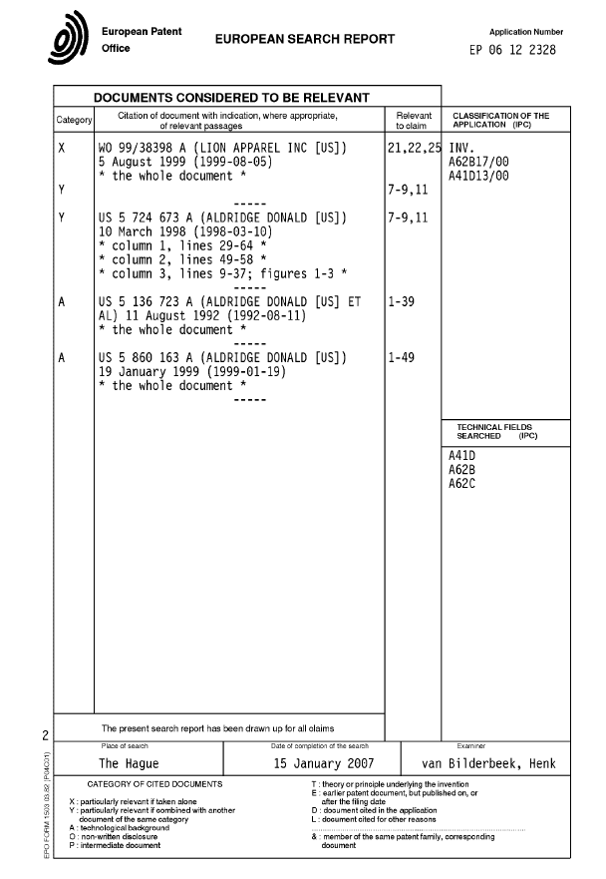
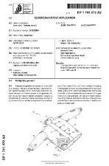
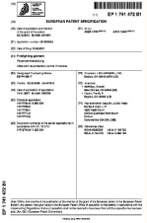
The grant procedure before the EPO
Withdraw?
Refusal?
Validation at
national offices
Invention becomes
visible to the public for the first time!
TR
y
DE
CH
RO
GB
CZ
FR
Application
filed
Search
report
Opposition
period expires
Publication
Examination
Grant
18 months
Approx. 3-5 years
9 months
Source: EPO/OHIM Intellectual Property Teaching Kit – IP Advanced Part
Notes:
37
The patent grant procedure before the EPO consists of the stages shown here on the slide.
When an application is filed, a search report is drawn up listing all the documents available to the EPO that may be relevant to assessing the novelty and inventive step of the invention. This is usually done before the patent application is published. Applicants can withdraw their application at any time, for example if conflicting prior art is found. If applications are withdrawn early enough, then the application is not published.
The application is published - normally together with the search report - 18 months after the date of first filing of the application. The published patent application provides some provisional protection even before it is granted.
After the request for examination has been made, the EPO examines whether a patent can be granted. If it decides that a patent can be granted, it issues a decision to that effect.
Once the mention of the grant of the patent is published, the patent has to be validated in each of the designated states within a specific time limit to retain its protective effect and to be enforceable against infringers. Different national requirements with regard to translation, representation, fees and time limits apply.
Third parties can oppose the patent on the grounds that it should not have been granted.
37

Slide 38
Finding freely available technologies in a country
t
File Search Examine Grant Oppose Renew Lapse Invalidate Expire
+ country choice

Slide 39
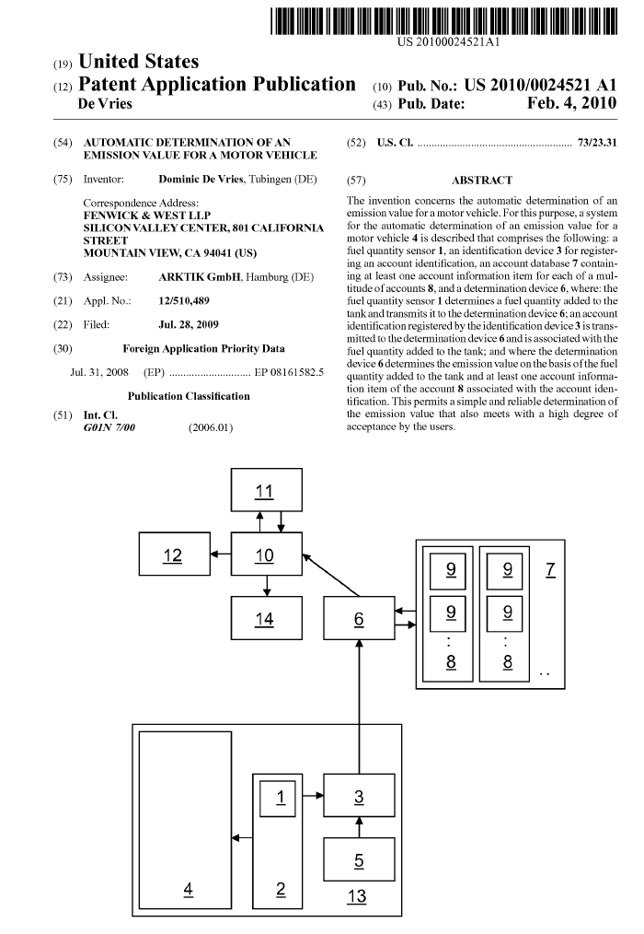
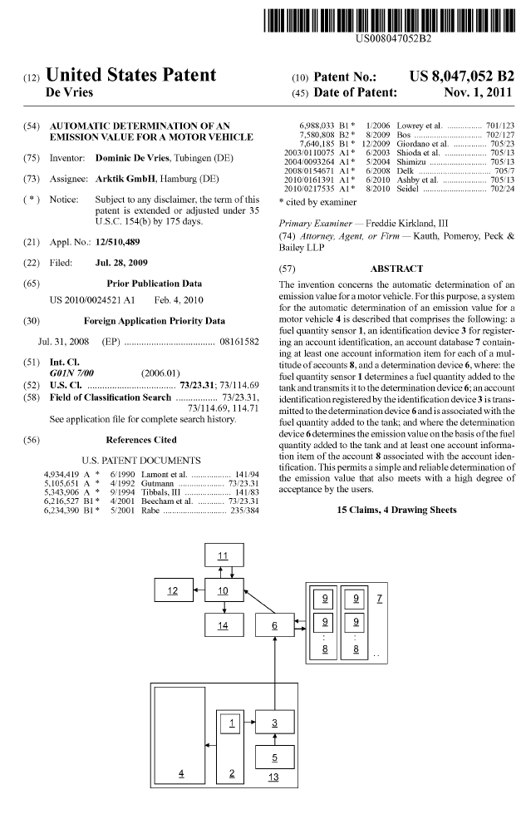
Important distinction: Patent application vs. granted patent
Kind code "A.."
Kind code "B.."

Slide 40
IP rights need to be kept alive
Patents: last up to 20 years, renewal fees need to be paid to keep the patent in force.
Trademarks: territorial, can last forever
if renewal fees are paid every 10 years, and used, and if kept from becoming generic.
Copyrights: Copyright is automatic, but the © symbol is usually used to make it clear to others that you are aware of the rights. Typically until after ~75 years after the originators death.
Registered designs: also territorial, separate applications need to be filed in different countries. Registered designs can typically last up to 25 years, renewal fees to be paid every 5 years.
Source: WIPO (2007); https://ipcopy.wordpress.com/2014/03/10/speculation-on-the-unitary-patent-renewal-fees-graphs-graphs-graphs-and-a-prediction/

Slide 41
Most patents are not kept alive for 20 years
8-10 years
Source: WIPO (2017). WORLD INTELLECTUAL PROPERTY INDICATORS 2017.

Slide 42
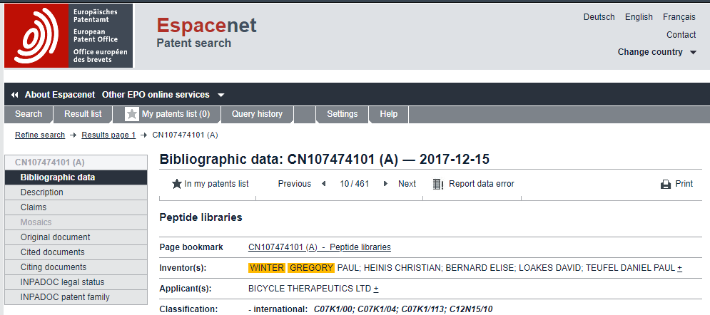
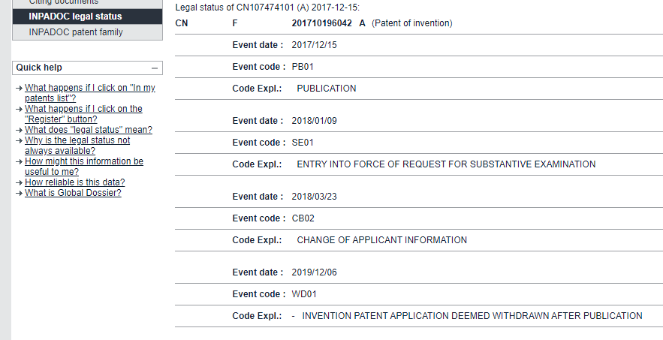
Legal status – INPADOC database

Slide 43
Patent searching exercise – Part I
Are there any of his inventions that you could use for free?
Use two databases:
ESPACENET (https://worldwide.espacenet.com)
The Lens (www.lens.org/lens )

Slide 44
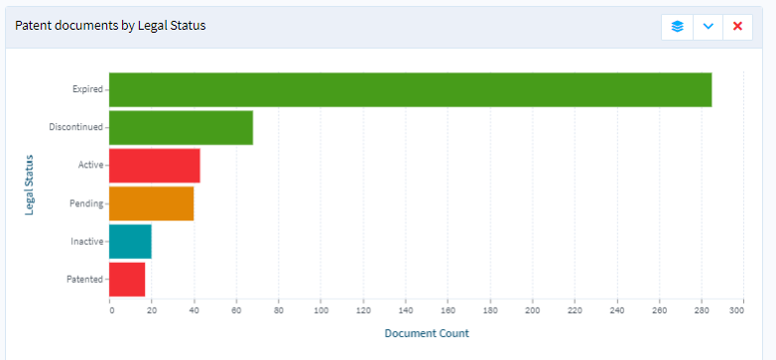

Slide 45
Databases
Creating reliable datasets
Patent data introduction
Different types of patent documents/ status
Patent families

Slide 46
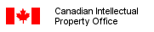
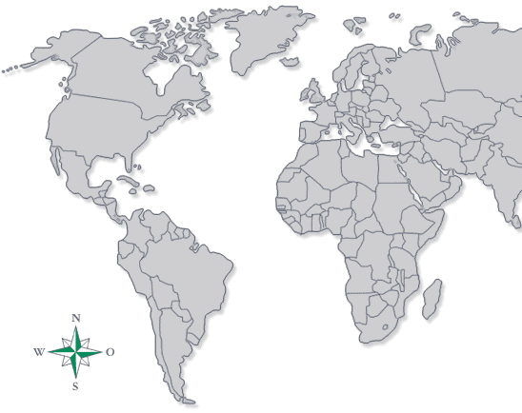


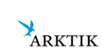
Patent families: A patent is a national right. A patent family is a collection of national patent consisting of one priority and subsequent patents
P_{1.a}
P₁
(Priority patent filed at
the EPO on 31.07.2008)
P_{1.b}
United States Patent and Trademark Office (USPTO)
Note: Patents of a family share the same ‘priority’ date
Source: Martinez, C., 2010. Insight into different types of Patent Families.
Martínez, C., 2011. Patent families: When do different definitions really matter? Scientometrics, 86(1), pp.39–63.

Slide 47
Simple patent families
A simple patent family is a set of patent applications filed in respect of a single invention, in multiple patent jurisdictions.
The first filing is the priority filing
Subsequent filings must occur within 12 months of the priority (Paris convention)
Subsequent filings "claim priority" from the first filing
Protection exists everywhere patent is in force

Slide 48
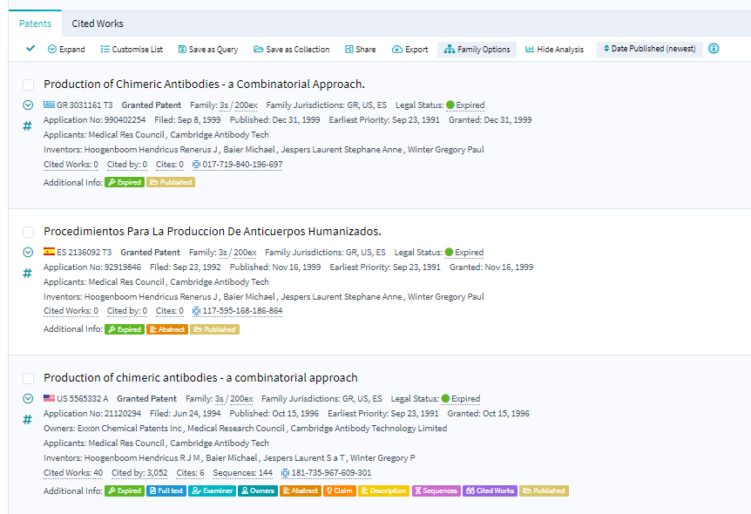
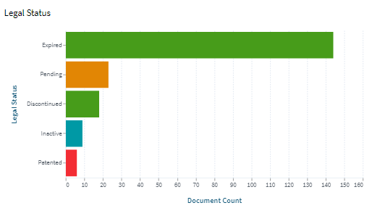
Beware of extended patent families
Simple Family
A simple patent family is a group of patent documents that stem from the same initial document, called the priority document. For example, an applicant might file a patent application in one country, then file other applications in other countries. The simple family covers one single invention.
Extended Family
An extended patent family is a collection of patent documents covering a technology – more than one single invention. The technical content covered by the applications is similar, but not necessarily the same. Members of an extended patent family will have at least one priority in common with at least one other member - either directly or indirectly.
Simple family: n=3
Extended family: m=200

Slide 49
Patent searching exercise
Optional homework
In 2018, you work for a biotech company as Head of IP that wants to manufacture a product that uses his invention:
“Peptide Libraries”
EP 2464727 B1 with Earliest Priority: Aug 12, 2009
Your company has plants in Belgium and France. Which location might you prefer?
You want to distribute and sell your product to Brazil and/or India. Will you have to worry about needing to negotiate a license?
Use two databases:
ESPACENET (https://worldwide.espacenet.com)
The Lens (www.lens.org/lens )

Slide 50
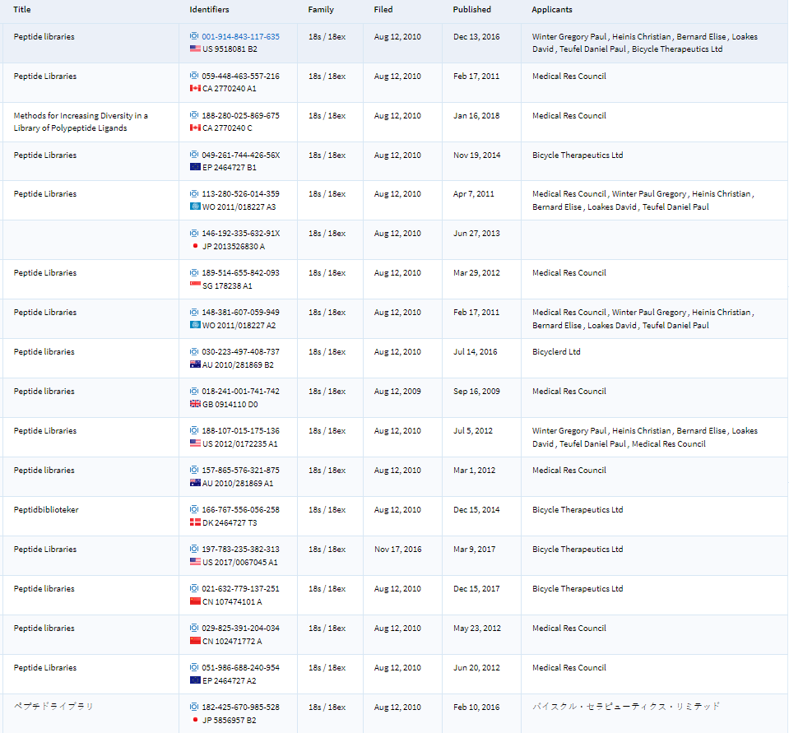
https://www.lens.org/lens/search/patent/table?n=50&extendedFamilyOf=113-280-526-014-359&preview=false

Slide 51
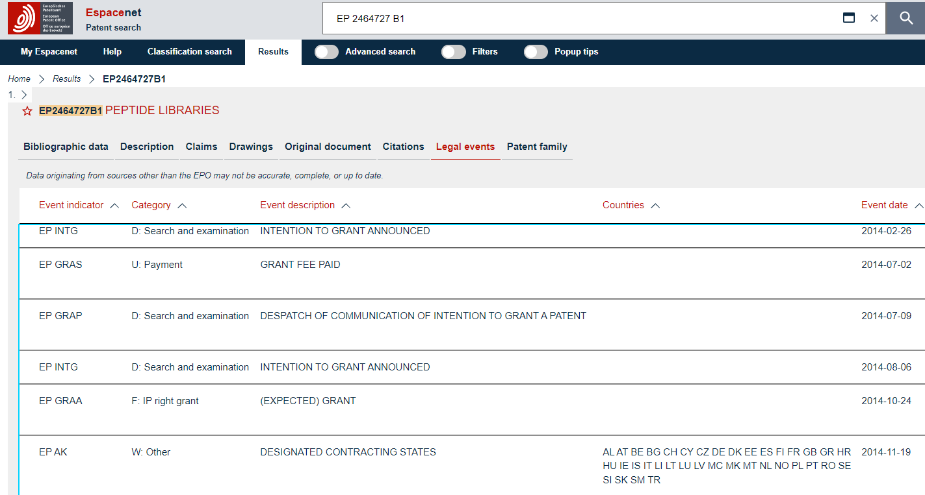
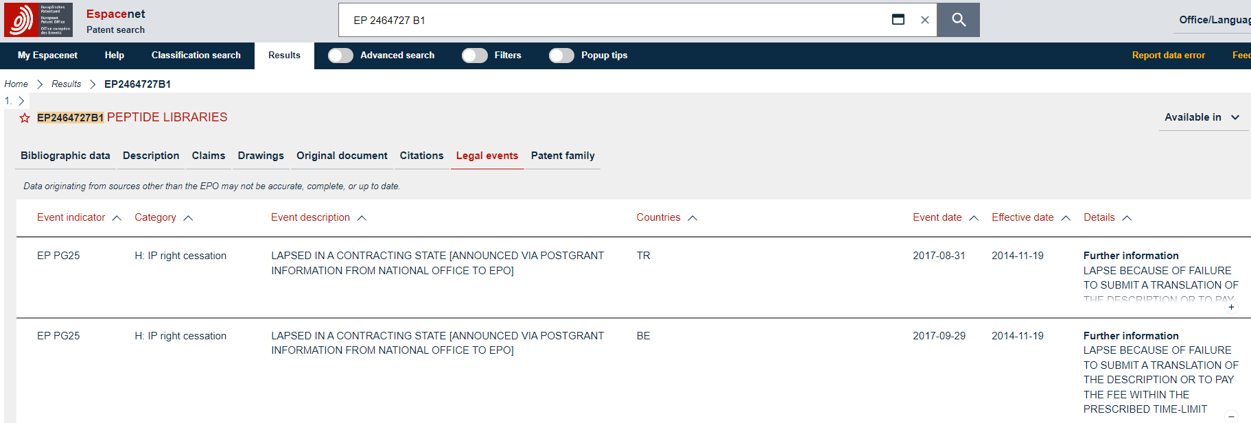
EP 2464727 B1
https://worldwide.espacenet.com/patent/search/family/041130043/publication/EP2464727B1?q=EP%202464727%20B1

Slide 52
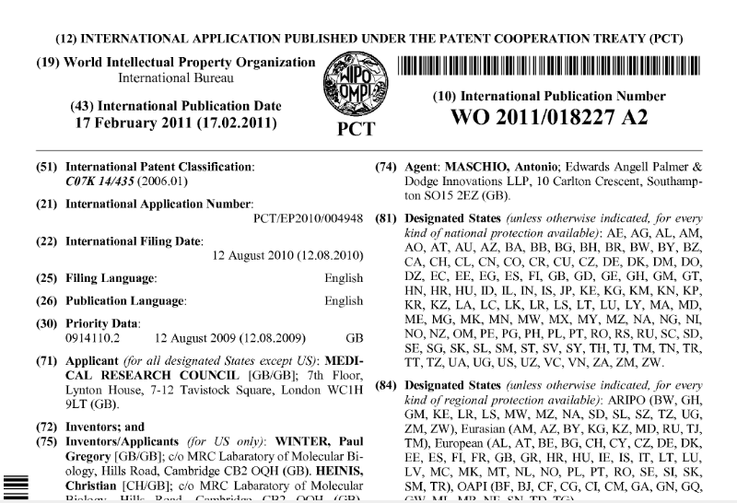
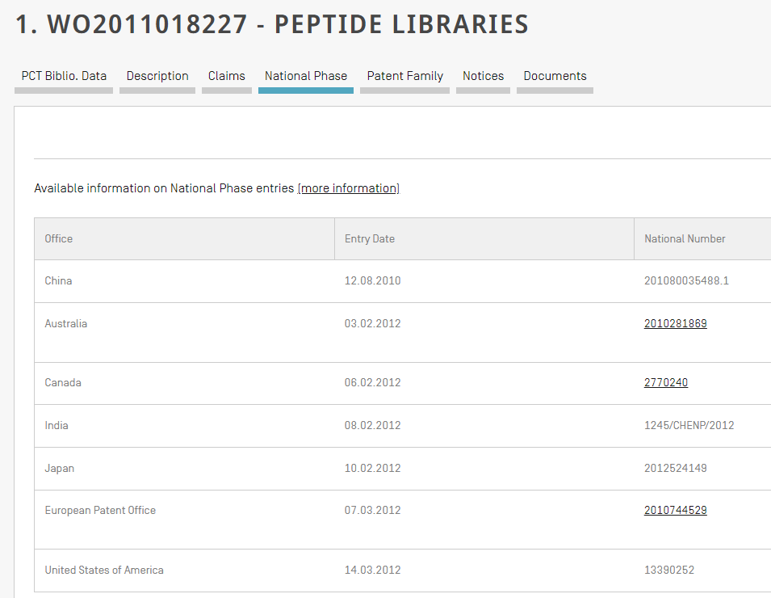
WO 2011/018227
https://patentscope.wipo.int/search/en/detail.jsf?docId=WO2011018227

Slide 53
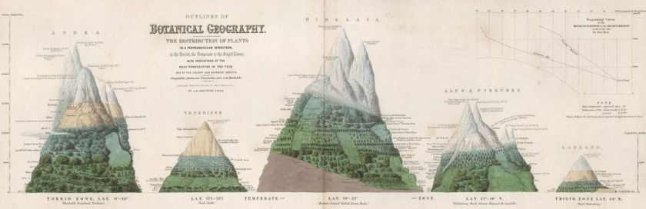
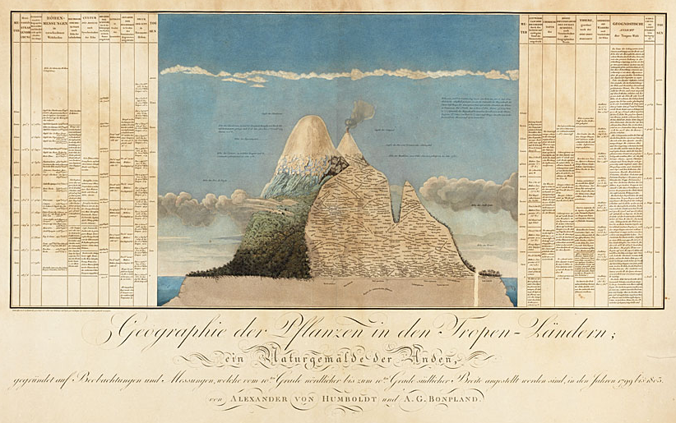
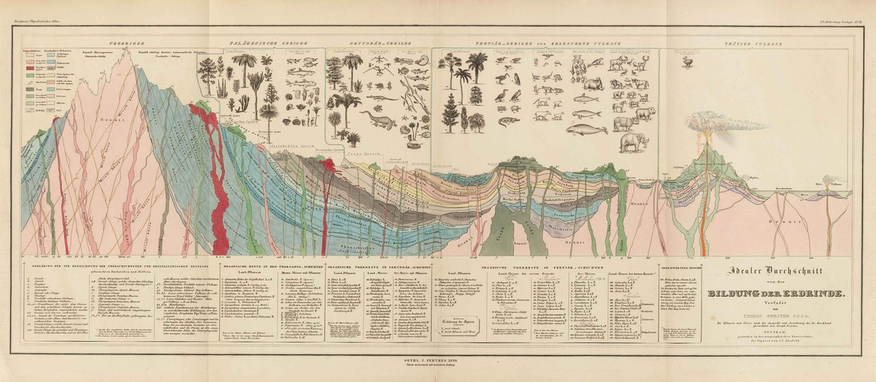
On creating powerful data visualizations

Slide 54
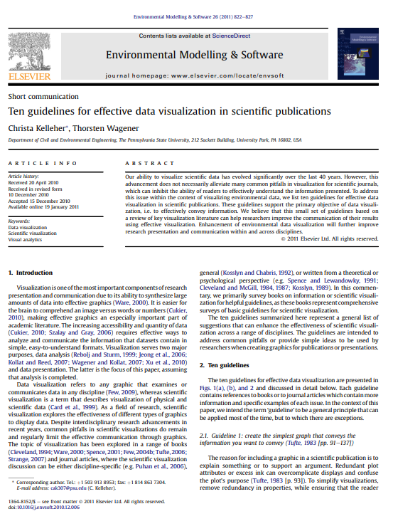
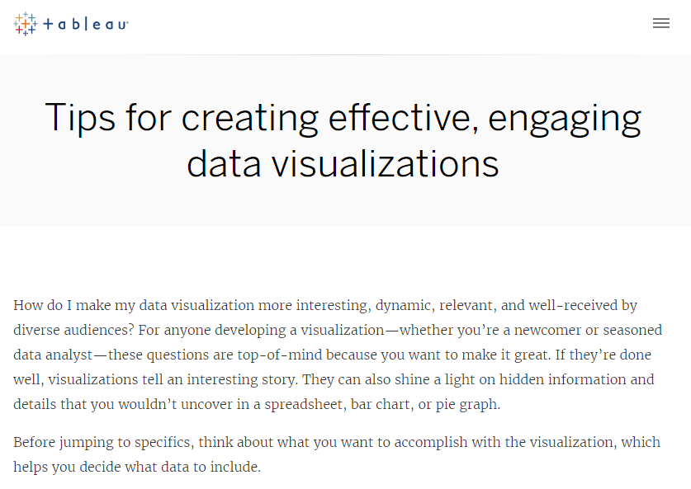

Effective representations of data matters
https://www.tableau.com/learn/articles/data-visualization-tips
https://doi.org/10.1016/j.envsoft.2010.12.006
https://blog.hubspot.com/marketing/types-of-graphs-for-data-visualization

Slide 55
Next
Teams to prepare interim presentations: max. 10 slides; max 10min + 5min Q&A
  Focus on pre-market launch patent analysis (technology development) for the technology your company is missing
  Identification of ~3 existing technical solutions and who owns them
  A patent-data based evaluation of the technical solutions identified + clear reasoning for the preferred solution
  An explanation of:
      how you developed your search strategy
      how you analysed the data
    Short reflection of your experience and challenges you encountered and limitations of the patent search

Slide 56
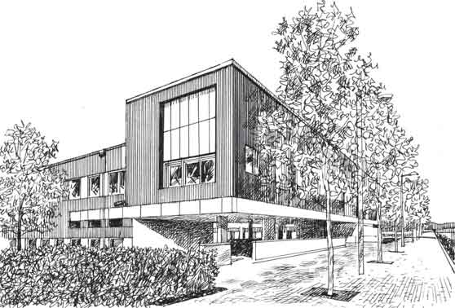
Thank you!

